Slide 1
Climate Change Intensification of Horizontal Water Vapor Transport in CMIP5
David A. Lavers, F. Martin Ralph, Duane E. Waliser, Alexander Gershunov, and Michael D. Dettinger
Citation: Lavers, David A., et al. "Climate change intensification of horizontal water vapor transport in CMIP5." Geophysical Research Letters 42.13 (2015): 5617-5625.
Sara Ross
ATMS 790
March 29, 2021

Slide 2
Presentation Outline
Motivations
Background Information
Data
Results
Summary
Methods

Slide 3
Abbreviations
CMIP5: Climate Model Intercomparison Project Phase 5
IVT: Integrated Vapor Transport
RCP: Representative Concentration Pathway
ERAI: European Centre for Medium-Range Weather Forecasts ERA-Interim
GCM: Global Circulation Model
JJA: June, July, August
DJF: December, January, February

Slide 4
Motivation and Introduction
Global warming will lead to an intensification of the global water cycle.
Past research has focused on precipitation to determine changes
Aim if this article: to investigate the vertically integrated water vapor using CMIP5.

Slide 5
Climate Model Intercomparison Project Phase 5
CMIP5
CMIP5 is meant to provide a type of framework for coordinating climate change experiments for the next 5 years.
CMIP5 promotes a standard set of model simulations in order to:
    Evaluate how plausible a model is at simulating past data
    Provides future climate projection (near term and long term)
    Looks at and quantifies key feedbacks
Important note: CMIP is NOT meant to comprehensive

Slide 6
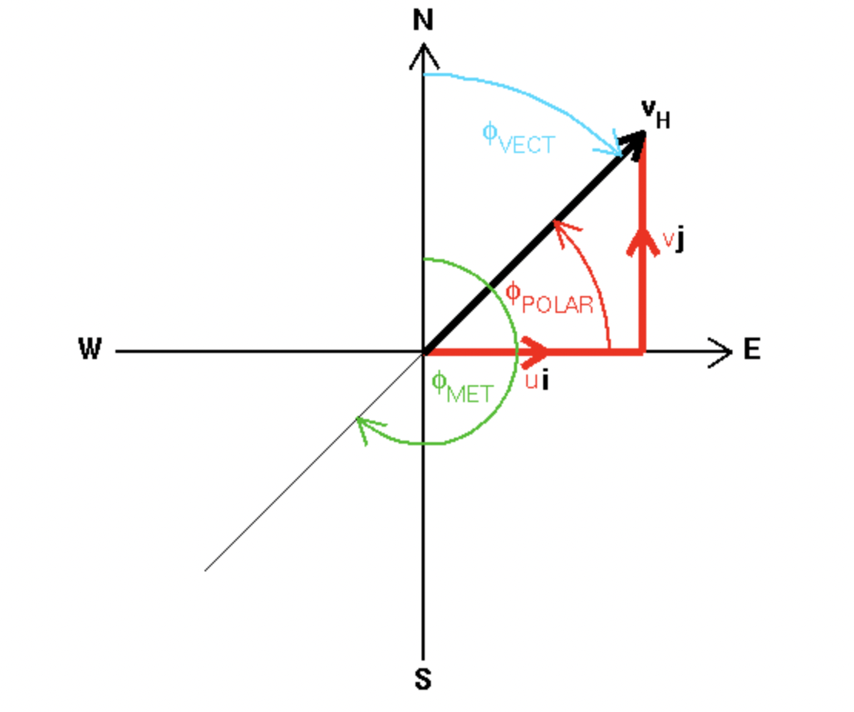
Winds
Meridional Wind (v)
The wind or wind component along the local meridian
Zonal Wind (u)
The wind or wind component along the parallel latitude
Image Source: http://tornado.sfsu.edu/geosciences/classes/m430/Wind/WindDirection.html

Slide 7
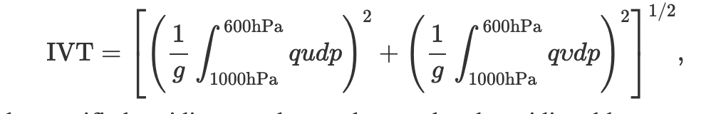
Water Vapor Transport
Integrated Vapor Transport
q: Specific Humidity
u: Zonal Layer-average Wind
v: Meridional Layer-averaged Wind
dp: Pressure Increment,
g: Acceleration Due to Gravity.
VT: is defined as a measure of the horizontal transport of specific humidity, by integrating it for a vertical column of the troposphere.

Slide 8
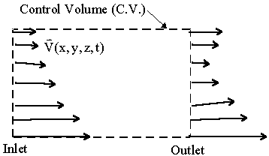
Eulerian Framework
Study prefers a Eulerian over a Lagrangian framework
Individual fluid particles are not identified
Instead, a controlled volume is defined
Function of Time and Space
Image Source: https://www.me.psu.edu/cimbala/Learning/Fluid/Introductory/descriptions_of_fluid_flows.htm

Slide 9
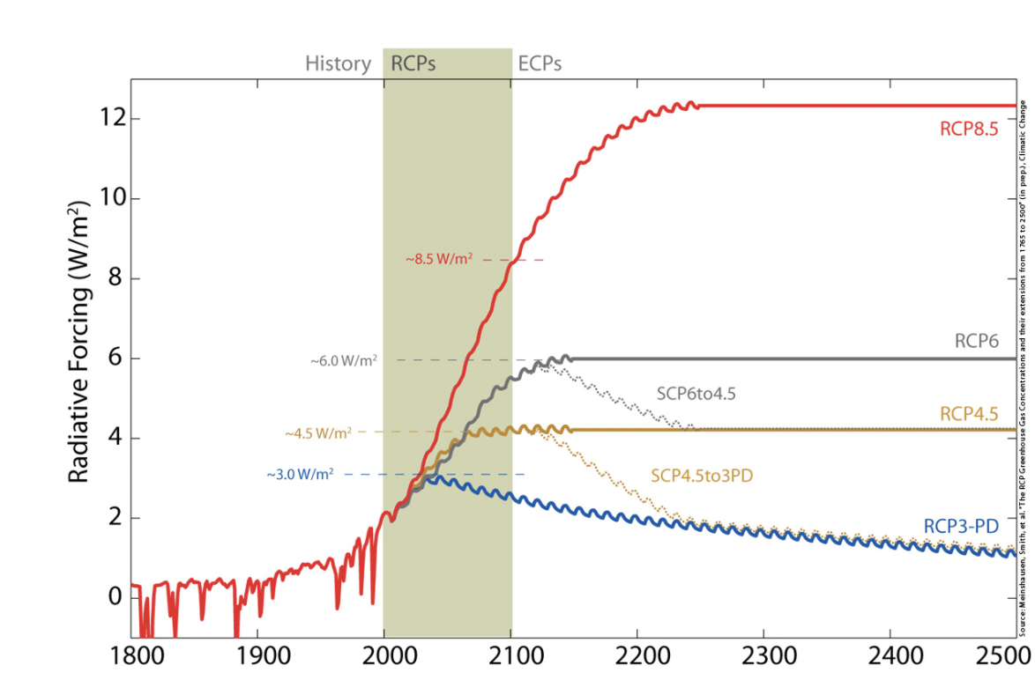
Emission Scenarios
RCP 4.5
Time series of emissions and concentrations of greenhouse gases and aerosols and chemically active gases
Land use/land cover
Intermediate stabilization pathway in which radiative forcing is stabilized at approximately 4.5 W m⁻² after 2100
Only 1 of 4 main Scenarios
Image Source: http://www.pik-potsdam.de/~mmalte/rcps/

Slide 10
Emission Scenarios
RCP 8.5
“Business as Usual” Scenario
High pathway for a radiative forcing that reaches greater than 8.5 W m⁻² by 2100 and continues to rise for some amount of time
Has the greatest impact on future climate
Highest pathway when looking at the common 4
  RCP 3.0 (reduction)
  RCP 4.5 (stabilize)
  RCP 6.0 (stabilize)
  RCP 8.5 (increase)

Slide 11
Data
22 GCMs from the CMIP 5
Models used had a horizontal resolution ranging from 1.125° × 1.125° to 2.813° × 2.813
Three simulations considered:
  Historical: 1979-2005
  RCP 4.5: 2073-2099
  RCP 8.5: 2073-2099
Calculated in the Eulerian framework
Daily data:
  Specific Humidity
  Zonal Wind
  Meridional Wind

Slide 12
Methods
Mean, Standard Deviation and 95th percentiles of the daily IVT at each grid point were calculated for each model
Time Steps with no IVT were masked before statistical analysis
Welch’s t Test was employed at each grid point
Area-Weighted global average mean IVT, specific humidity and wind changes between historical and RCP scenarios were also calculated and summarized

Slide 13
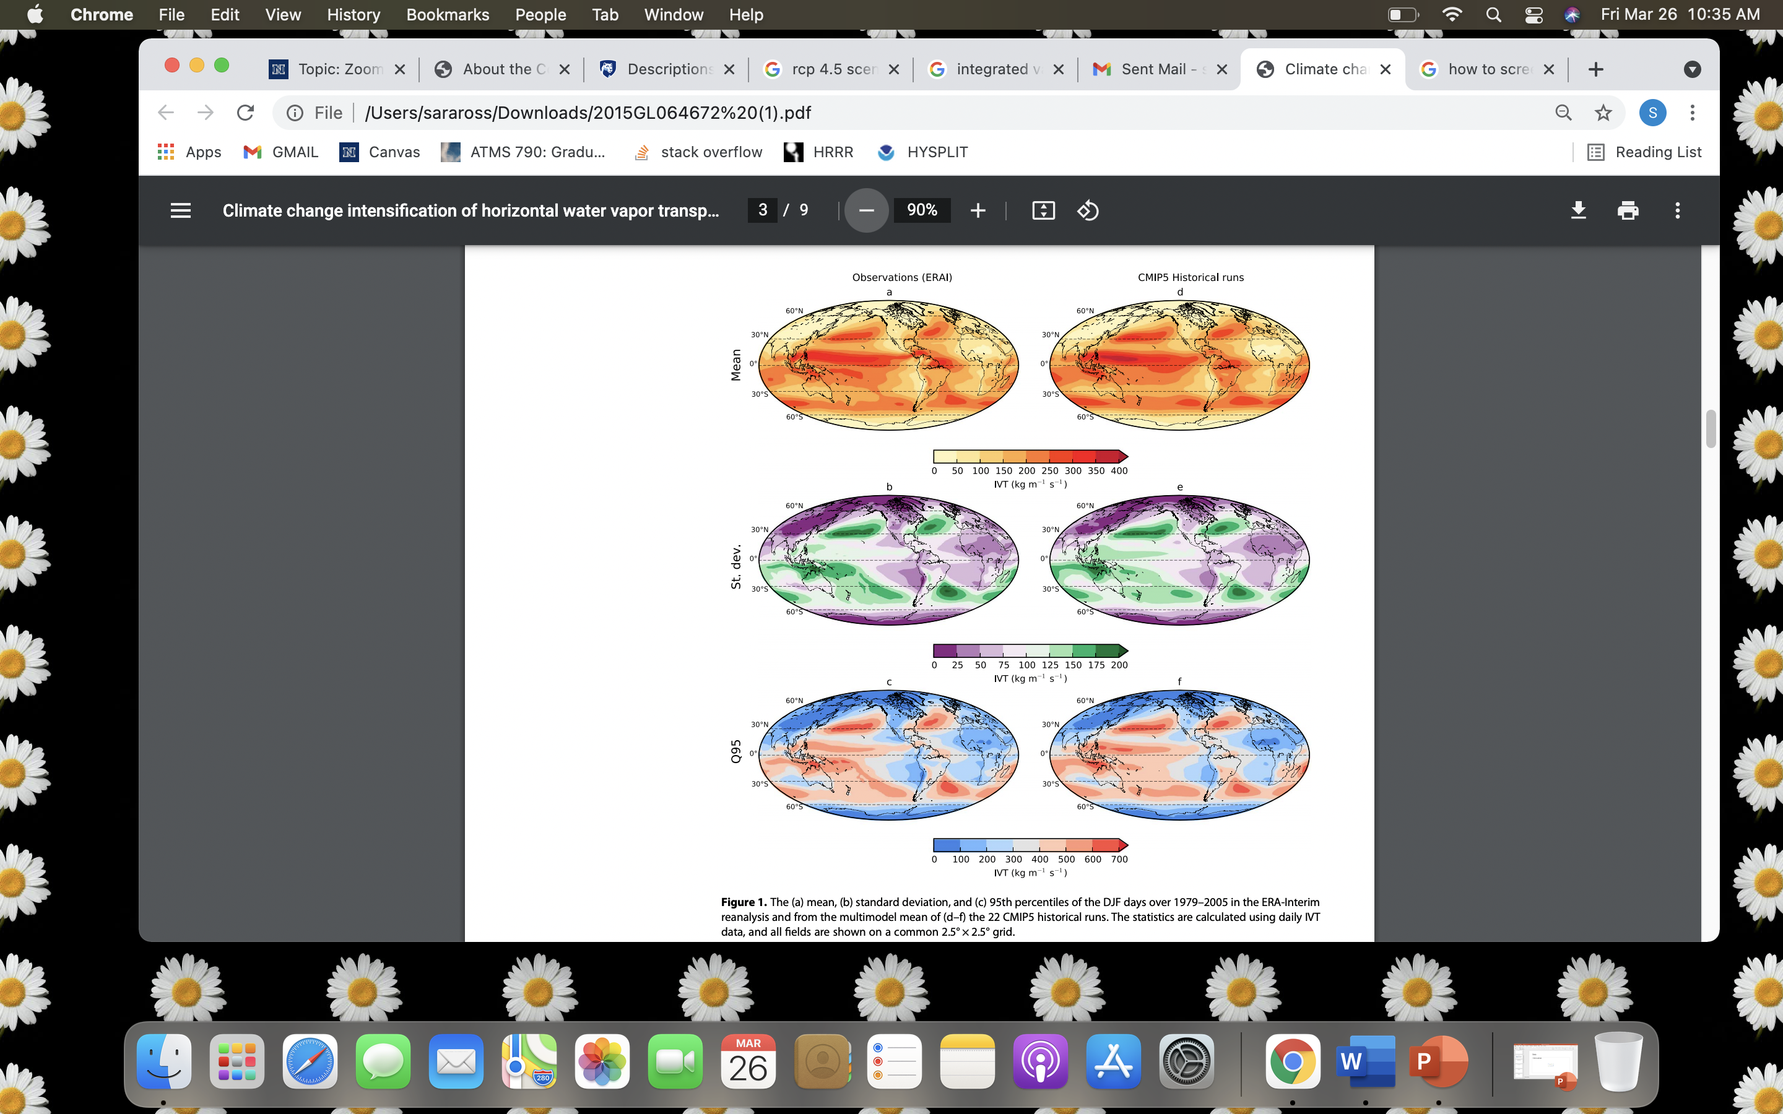
Results
DJF days over 1979-2005
IVT is associated with extratropical cyclones
Figure 1 in article
All fields shown on a common 2.5 degree by 2.5-degree grid
ERA-Interim Reanalysis compared to CMIP Historical run
Variability greatest in the midlatitudes

Slide 14
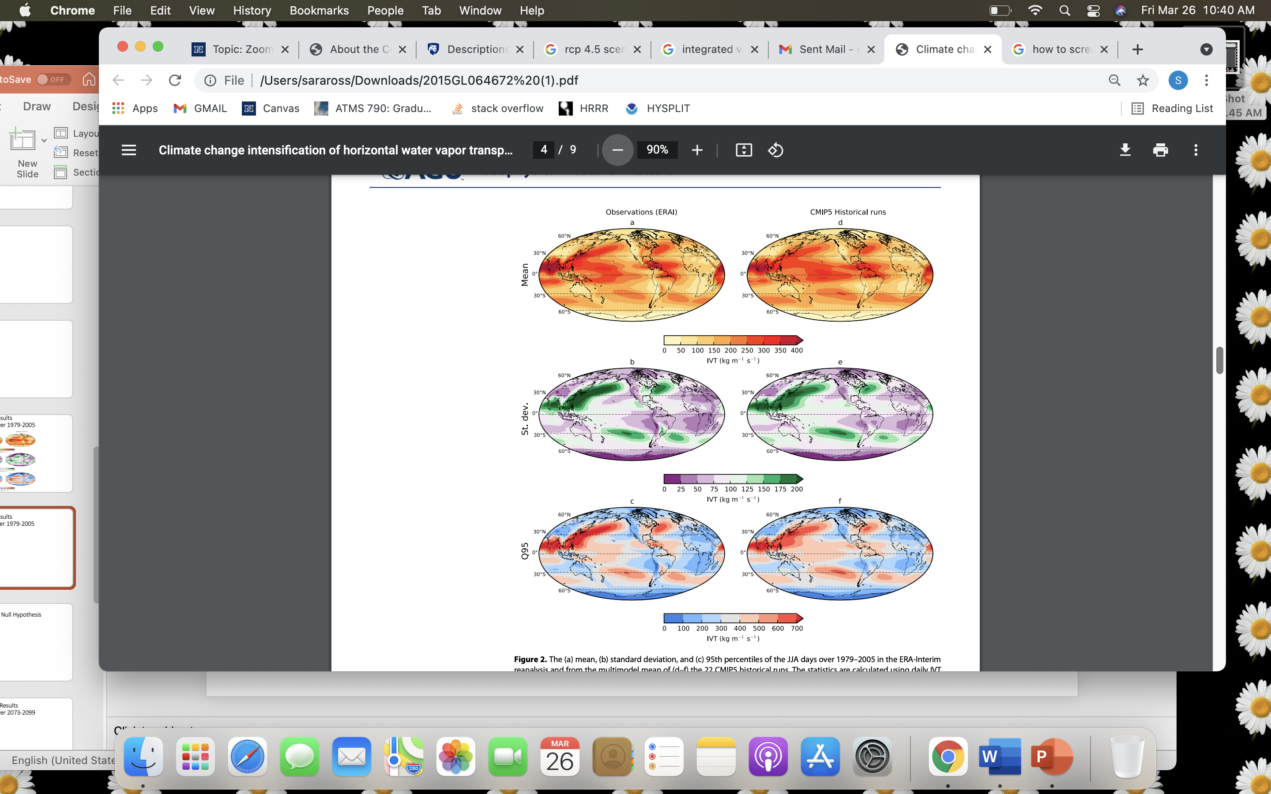
Results
JJA days over 1979-2005
Figure 2 in article
All fields shown on a common 2.5 degree by 2.5-degree grid
ERA-Interim Reanalysis compared to CMIP Historical run
Take note of the high multimodel signal over the eastern equatorial Pacific

Slide 15
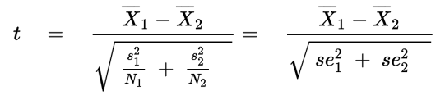
Welch’s t Test Null Hypothesis
X: Sample Mean
S: Sample Standard Deviation
N: Sample Size
Welch’s Test for Unequal Variance is a modification to the standard student t test to see if two sample means are vastly different
Null Hypothesis: is a statistical theory that suggests that there is no statistical relationship and significance that exists in a set of given variables
Variance: is a measure of variability, tells us the degree of spread that might be in a data set

Slide 16
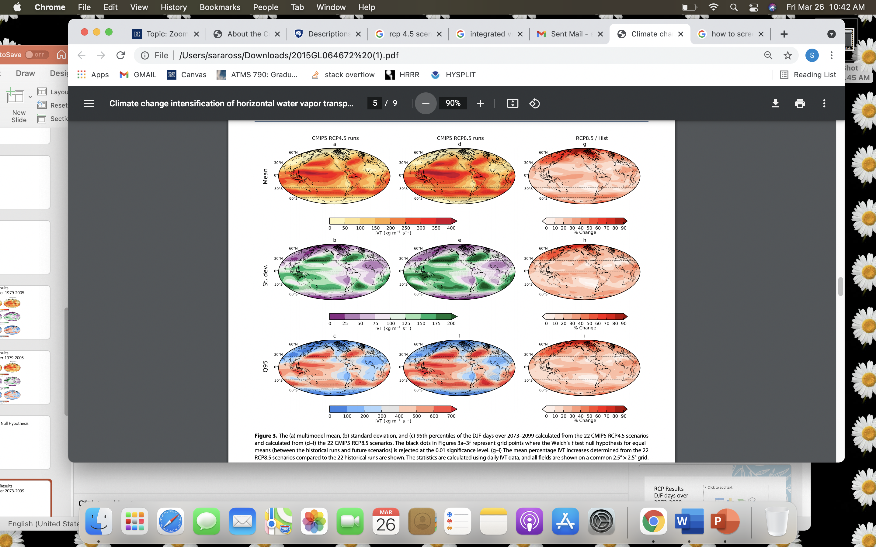
RCP Results
DJF days over 2073-2099
Figure 3 in article
CMIP5 RCP Data
All fields shown on a common 2.5 degree by 2.5-degree grid
Black dots in images a-f represent grid points where the Welch’s t test null hypothesis for equal mean is rejected
0.01 significance level

Slide 17
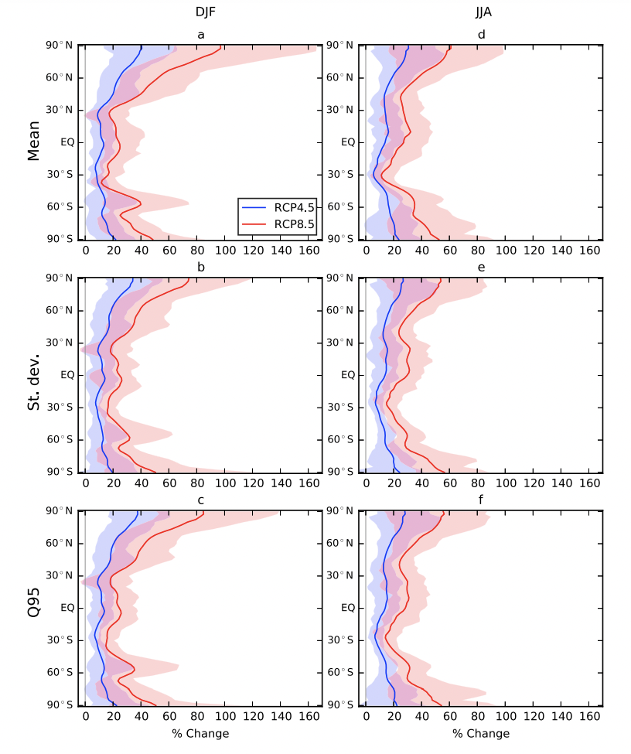
Zonal Average percentage change
DJF and JJA for 1979-2005 to 2073-2099
Figure 4 in article
Range of the percentage changes in the RCP4.5 and RCP8.5 scenarios is given by the blue and red envelopes, respectively
The thick blue and red lines are the multimodel mean percentage changes from the RCP4.5 and RCP8.5 scenarios in the 22 CMIP5 models

Slide 18
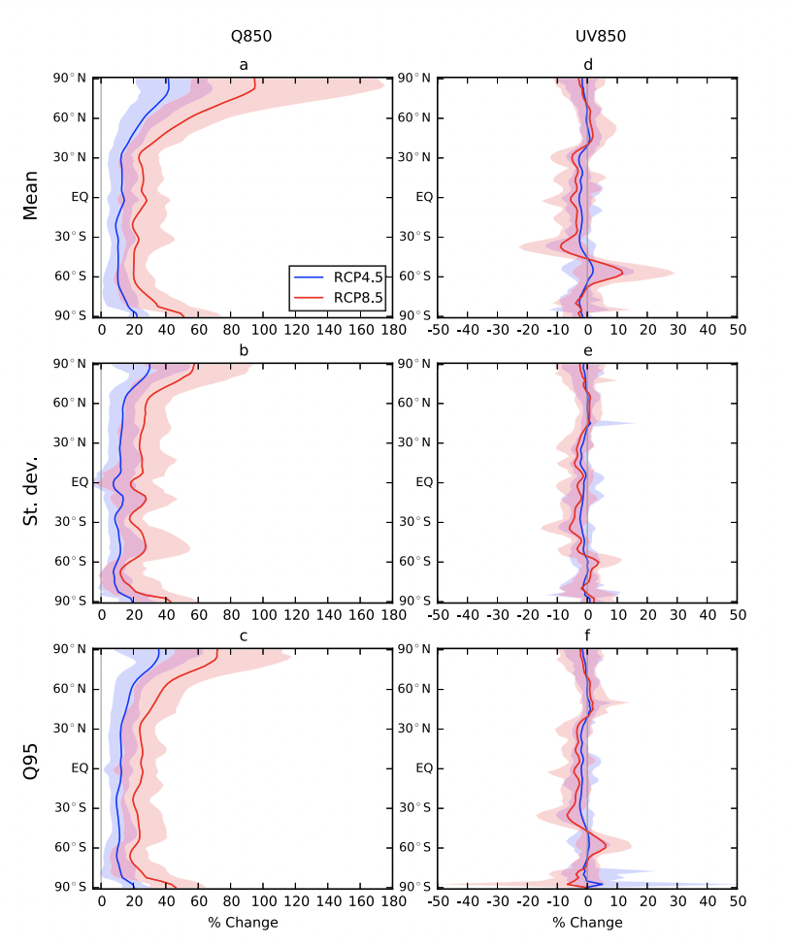
Zonal Average Percentage Changes
850 hpa specific Humidity and Wind magnitudes
Figure 5 in article
DJF from 1979-2005 to 2073-2099
The range of the percentage changes in the RCP4.5 and RCP8.5 scenarios are given by the blue and red envelopes
The thick blue and red lines are the multimodel mean percentage changes from the RCP4.5 and RCP8.5 scenarios
Values less than 0.001 were masked to guard against extremely high percentage change values.

Slide 19

Summary
The atmospheric water vapor flux, as given by the mean and 95th percentiles of IVT, will intensify under projected climate change
The high-latitude IVT exhibits the largest percentage increases, especially during DJF
The IVT variability characterized by the standard deviation will increase.
Results suggest that the changing IVT statistics are predominantly due to increasing low-altitude specific humidity

Slide 20
Questions?
Email: saraross@nevada.unr.edu

Slide 21
References
Climate Model Intercomparison Project
http://cmip5.whoi.edu/?page_id=55
Eulerian Framework
https://www.me.psu.edu/cimbala/Learning/Fluid/Introductory/descriptions_of_fluid_flows.htm
RCP
https://www.ipcc-data.org/guidelines/pages/glossary/glossary_r.html
https://sos.noaa.gov/datasets/climate-model-temperature-change-rcp-45-2006-2100/
Water Vapor Transport
https://journals.ametsoc.org/view/journals/clim/33/1/jcli-d-19-0348.1.xml
Welch’s t Test Null Hypothesis
https://www.statisticshowto.com/welchs-test-for-unequal-variances/#:~:text=Welch's%20Test%20for%20Unequal%20Variances%20(also%20called%20Welch's%20t%2Dtest,sample%20means%20are%20significantly%20different.&text=The%20null%20hypothesis%20for%20the%20test%20is%20that%20the%20means%20are%20equal

